Slide 1
Digital Skills for an Ageing Europe
Working on your analytical skills:
scenario making for executive cognitive functions
Project number 2020-1-FR01-KA204-079823

Slide 2
Summary
Glossary
Introduction
Unit 1 – About Scenario Making
Unit 2 – Learning Outcomes
2.1 Critical and Analytical Thinking
2.2 Problem Solving
2.3 Creativity
2.4 Cognitive Reactiveness
2.5 Design Thinking
Unit 3 – The Scenario Making exercise
3.1 How do you define a scenario
3.2 A taxonomy of scenarios
3.3 Evolution
3.4 Revolution
3.5 Cycle
3.6 Long ranger

Slide 3
Description and objectives
In this module, learners will have the opportunity to experiment and familiarise with a technique that is highly beneficial for their executive functions.
We will talk about scenario making and how this skills can better help learners in navigating their daily social and relational ecosystems.
At the end of this module, you will be able to get a bit more familiar with your:
reasoning
critical thinking
sense of self-efficacy.

Slide 4
Glossary
Word | Definition
Creativity | Creativity is most commonly defined as the ability of coming up with something new, innovative, and unexpected. In the context of scenario making, creativity refers also to the person’s ability to: Look at things from multiple perspectives Find new meanings to events and peoples’ way(s) of acting Give new purposes to actions
Critical Thinking | By critical thinking, we refer to that subconscious action that we all rely on to: Understand our surroundings (gathering external Inputs) Process the information (elaborate the source and nature of inputs) Formulate cognitive and behavioural responses (generate an output)
Problem Solving | Problem solving includes a series of proactive cognitive and behavioural reposes that we invest to overcome an unpleasant situation. Assessing of the underlie need (i.e., problem) Understand cause-effect dynamics (i.e., context variables) Generate a coherent solution (i.e., countermeasure)
Decision Making | The process leading to the formulation of decisions and coherent actions
Design Thinking | According to a common definition, design thinking is about stimulating ideas that generate value.
Analytical Thinking | The capability to extrapolate meaningful information from a problem-solving scenario, identify key elements of relevance to develop practical solutions
Project number 2020-1-FR01-KA204-079823

Slide 5
Unit 1. About Scenario Making
Scenario making (aka scenario thinking and scenario analysis) is a method deriving from military intelligence.
Businesses and organisation began to rely on it to define and brainstorm on long-term strategic plans.
In recent years, scenario making became quite common even in other Social Sciences.
Project number 2020-1-FR01-KA204-079823

Slide 6
Unit 1. About Scenario Making
Scenario making implies sophisticated cognitive abilities that help people in anticipating and understanding plausible futures, their most likely outcomes, and adequate ways to approach these alternative scenarios from a behavioural perspective.
Particularly in Psychology (psychotherapy), scenario making is used by professionals to help people in building confidence, greater self-efficacy and self-awareness.
Project number 2020-1-FR01-KA204-079823

Slide 7
Unit 2. Learning Outcomes
The scenario making exercise can be used to strengthen your:
Critical (aka Analytical) thinking
Problem solving
Creativity
Cognitive reactiveness to emotional and spatial stimuli
Design Thinking
Project number 2020-1-FR01-KA204-079823

Slide 8
Unit 2. Learning Outcomes
2.1 Critical (and Analytical) thinking
By critical thinking, we refer to that subconscious action that we all rely on to:
Understand our surroundings (gathering external Inputs)
Process the information (elaborate the source and nature of inputs)
Formulate cognitive and behavioural responses (generate an output)
Project number 2020-1-FR01-KA204-079823

Slide 9
Unit 2. Learning Outcomes
2.2 Problem Solving
Problem solving includes a series of proactive cognitive and behavioural reposes that we invest to overcome an unpleasant situation. Problem solving starts with:
Assessing of the underlie need (i.e., problem)
Understand cause-effect dynamics (i.e., context variables)
Generate a coherent solution (i.e., countermeasure)
Project number 2020-1-FR01-KA204-079823

Slide 10
Unit 2. Learning Outcomes
2.3 Creativity
Creativity is most commonly defined as the ability of coming up with something new, innovative, and unexpected.
In the context of scenario making, creativity refers also to the person’s ability to:
Look at things from multiple perspectives
Find new meanings to events and peoples’ way(s) of acting
Give new purposes to actions
Project number 2020-1-FR01-KA204-079823

Slide 11
Unit 2. Learning Outcomes
2.4 Cognitive reactiveness
With scenario making’s exercises, you have the opportunity to trigger more sophisticated cognitive and behavioural responses to external stimuli in ways that you might have never considered.
In other words, scenario making’s exercises help you in consolidating a renewed mind-set through which you interface and approach both complex and ordinary daily-life experiences.
Project number 2020-1-FR01-KA204-079823

Slide 12
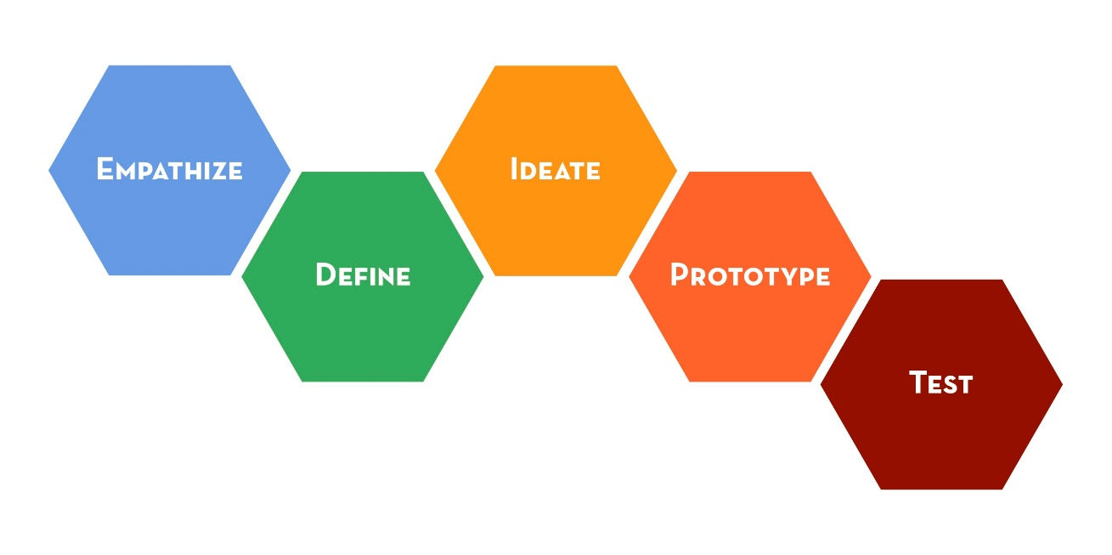
Unit 2. Learning Outcomes
2.5 Design Thinking
According to a common definition, design thinking is about stimulating ideas that generate value.
The essential reference model is provided by the Design Thinking Lab of Stanford University.
Source: d.school (Stanford University)
Project number 2020-1-FR01-KA204-079823

Slide 13
Unit 3. The Scenario Making exercise
3.1 How do you define a scenario?
Regardless of the specific context in which the scenario applies, scenario making is really about 4 key steps:
Define the issue (i.e., starting point)
Gather data (i.e., resources)
Separate certainties from uncertainties (i.e., variables on which you can have an influence VS those on which you can’t)
Evaluate what might happen if…
Project number 2020-1-FR01-KA204-079823

Slide 14
Unit 3. The Scenario Making exercise
3.2 A taxonomy of scenarios
Scenarios can be of 4 kind:
Evolution
Revolution
Cycles
Long ranger
The most suitable decision(s) to navigate each one of them depends on your expectations and the situation you are currently in.
Project number 2020-1-FR01-KA204-079823

Slide 15
Unit 3. The Scenario Making exercise
3.3 EVOLUTION
Evolutionary scenarios are those in which the given circumstances remain the same and are reinforced by specific actions/decision aimed at retaining the status quo.
Evolution-based decisions are those you will rely on in the case the scenario you are faced with is favourable and positive.
Project number 2020-1-FR01-KA204-079823

Slide 16
Unit 3. The Scenario Making exercise
EVOLUTION - example
The sentimental relation between you partner is doing great, you are very engaged in your sentimental commitment….
…What can you do to keep up with the same energies?
Please, feel free to indicate a series of potential alternatives / options
Project number 2020-1-FR01-KA204-079823

Slide 17
Unit 3. The Scenario Making exercise
3.4 REVOLUTION
On the contrary, revolutionary scenarios are those that disrupt the current dynamics and flow of events.
Revolution-based actions and decision are desired when you wish to generate a change for the better.
Project number 2020-1-FR01-KA204-079823

Slide 18
Unit 3. The Scenario Making exercise
REVOLUTION - example
Your son / daughter has a poor performance at school…
…what can you do to be in their support?
Please, feel free to indicate a series of potential alternatives / options
Project number 2020-1-FR01-KA204-079823

Slide 19
Unit 3. The Scenario Making exercise
3.5 CYCLE
Cycle-based actions imply the conscious decision of NOT reacting and waiting for things to happen. This might seems at first as a surrender to events. However, cycle-based (non) actions are not necessarily a bad option when:
Our decision(s) might cause more damage than benefits
There is a lack of enough information to take any position
Contextual variables outnumber the ones we can have an influence on
Project number 2020-1-FR01-KA204-079823

Slide 20
Unit 3. The Scenario Making exercise
CYCLE - example
Your team colleagues are receiving the news of a promotion but the HR department is still silent on your case…
…how do you react to that?
Please, feel free to indicate a series of potential alternatives / options
Project number 2020-1-FR01-KA204-079823

Slide 21
Unit 3. The Scenario Making exercise
3.6 LONG RANGER
As the term implies, long shot-decisions are those oriented to generate an impact in the long run.
Actions and decisions of such kind are conceived to remain consistent and coherent to the design of a “bigger picture” not necessarily tangible in the here and now. Typical – but not exclusive to – investment decisions.
Project number 2020-1-FR01-KA204-079823

Slide 22
Unit 3. The Scenario Making exercise
LONG RANGER - example
You just received a generous donation from one of your family member…
…Would you rather invest this money in gold (low risk / steady but low profit margin) or in cryptocurrencies (high volatility / high risk / high profit margin)?
Please, feel free to indicate a series of potential alternatives / options
Project number 2020-1-FR01-KA204-079823

Slide 23
You’ve reach the end of this course, congrats!
Let’s keep in touch!
Write us an email: disk-project@googlegroups.com
Visit our website and play mini-games: https://diskproject.eu/
Project number 2020-1-FR01-KA204-079823

